Slide 1
DELIVERING PROMISES
HOW TO SOLVE THE RETURNS CHALLENGE IN LOGISTICS?

Slide 2
Objectives
Develop an understanding of both logistics and reverse logistics
Raise awareness of the issues that can occur in clothing returns logistics
Suggest ways that manufacturers, retailers and customers could help to solve the issues
Share your contributions to have the option to win a prize!

Slide 3
Logistics Management

Slide 4
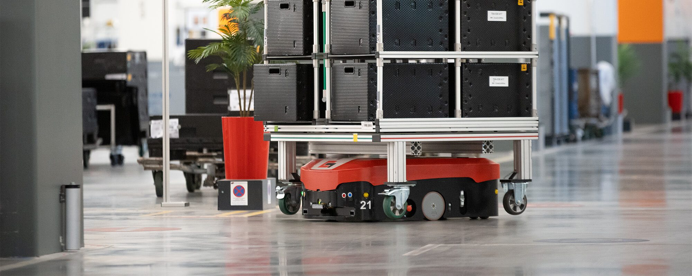
Automation
Back-office automation, using technology like “electronic data interchange” to match purchase orders and invoices without manual intervention
Guided vehicles in warehouses and “last mile” delivery to customers to meet supply needs
Dark warehouses automate put away, picking and packing using ultrasound or infra-red sensors to avoid other equipment and other robots
BUT! Returns (“reverse logistics”) are much more challenging…

Slide 5
Reverse Logistics
Reverse logistics involves all of the actions necessary to get a product back from the customer to where the product came from.
Reverse logistics includes returns, which can be a result of damage, inaccuracies and unwanted purchases.

Slide 6
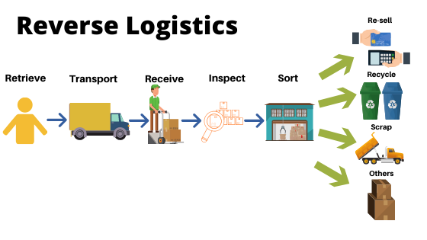
Reverse Logistics

Slide 7
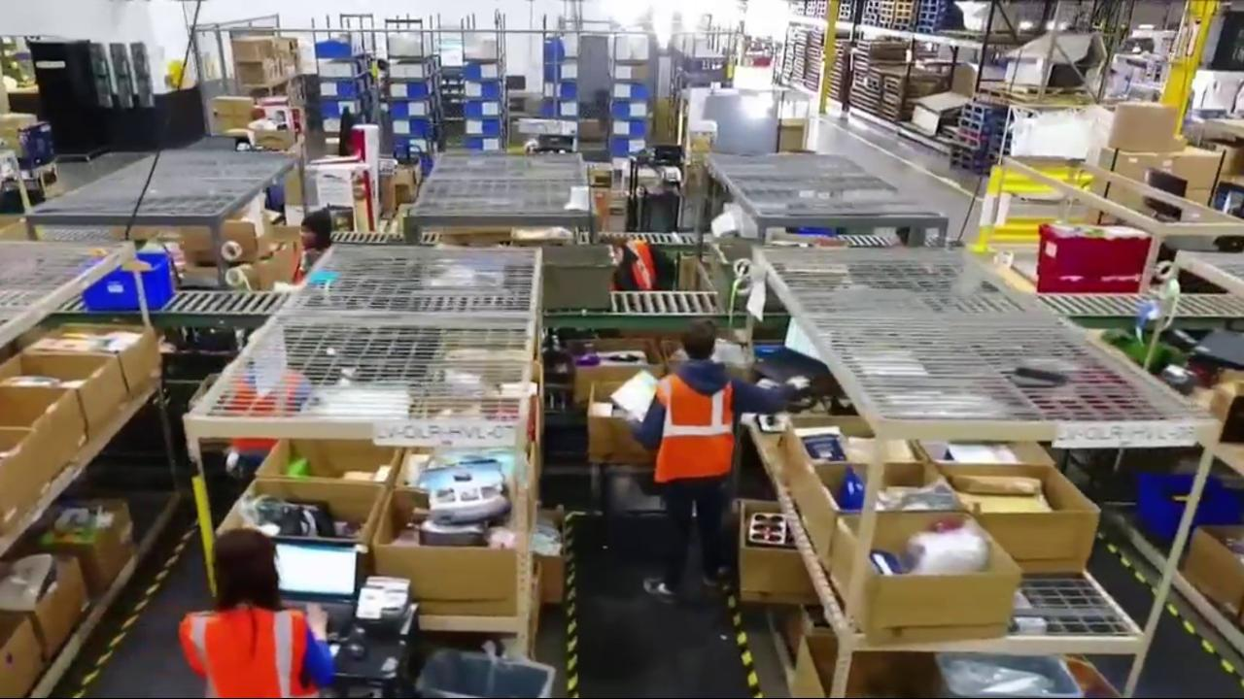
Reverse Logistics Challenges
“Free returns” are expected, but cause a hit to the bottom line of businesses – and customers may take advantage!
Automation is challenging, because the small quantities being handled do not make an investment worthwhile
Manual, time-consuming processes are often needed to determine whether the returned goods should be repackaged, repaired or recycled
5-10% of in-store purchases are returned, but this rises to 15-40% of online purchases that are returned!

Slide 8
Online ordering and returns
The Statistics
£141.33 billion forecast to be spent online in 2021
e-commerce (shopping online) accounts for 30% of total retail sales in the UK
Amazon has reached 55% year-on-year growth…
…SHEIN reached 490%!
An average returned purchase in the UK passes through seven pairs of hands before it is listed for resale
Every day, thousands of packages begin their costly journey through warehouses, where products are cleaned, repackaged and prepared for resale.
By the time the product makes it back into stores, the product might be out of season and then need to be sold at a discount.

Slide 9
Challenges
Cost
Hedge Spending
Buying items at full price in the knowledge that items can be returned if they are discounted later is increasing because of the ease of checking and comparing.
Free returns are expected, but people take advantage…
Serial Returners
Intentional Returns
1/5 of online fashion purchases include an order with multiple items of a similar size, shape or colour, as customers deliberately over-order, knowing that returns are free or cheap.
56% of people who bought clothes online in the last six months sent at least one item back.

Slide 10
Customer Experience
What makes people buy…and keep?
Personalisation: Personalised shopping experiences lead to greater customer satisfaction
Data collection
Recently viewed items
Returning customer discount
Augmented reality: Creating an in-store experience at home
Virtual dressing rooms
360◦ models
Customer service
Live chat
Chatbots

Slide 11
Your Task
How could the following people work better together to solve the returns challenge for clothes?
Manufacturers
Logistics companies
Retailers (shops)
Customers
There is no right or wrong choice or solution
Be prepared to share your answers

Slide 12
Points to consider
M
Why do people return clothes?
How could we make clothes that people don’t want to return?
L
How could we make returns less appealing to customers?
What could we do to make returns more environmentally friendly?
R
How could we make returns less appealing to customers?
How could we help customers make choices that they won’t want to return?
C
How could we educate people about why returns are not good for the environment?
How could we ask people to change their behaviours?
Other
How could people in these areas work together to reduce returns?
Could we have a campaign ? What messages would you recommend?

Slide 13
Visions of a Sustainable Future
THANK YOU!

